Slide 1
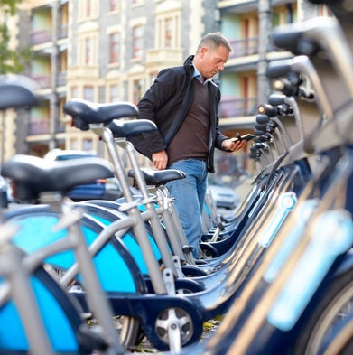

CAPSTONE PROJECT:
Cyclistic Bike Share Company Chicago
12 Month Users’ Analysis; determining the difference between Casual Riders and Annual Members.
SEGUN OLUBIMO AUGUST 2022

Slide 2
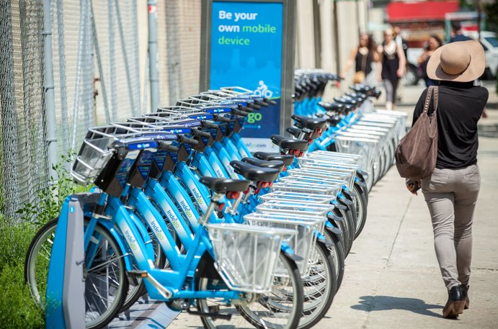
TABLE OF CONTENT
Business Objective
Business Task
Data, Processes and Tools
Visualizations
Findings
Recommendations

Slide 3

Business Objective
Design marketing strategies aimed at converting casual riders into annual members. In order to do that, however, the team needs to better understand how annual members and casual riders diﬀer, why casual riders would buy a membership, and how digital media could aﬀect our marketing tactics.

Slide 4
Business Tasks
Answer the following questions to help the execution of the new marketing strategy;
How do annual members and casual riders use Cyclistic bikes diﬀerently?
Why would casual riders buy Cyclistic annual memberships?
How can Cyclistic use digital media to inﬂuence casual riders to become members?
This presentation answers the first question, which is my specific task.

Slide 5

Data
Process
& Tools
Our data is a public data and can be found at (https://divvy-tripdata.s3.amazonaws.com/index.html) and the license can be found at https://www.divvybikes.com/data-license-agreement.
Cleanups was done using Excel spreadsheet.
Analysis was done using R / Rstudio
Final analysis and visualization was done with Tableau

Slide 6
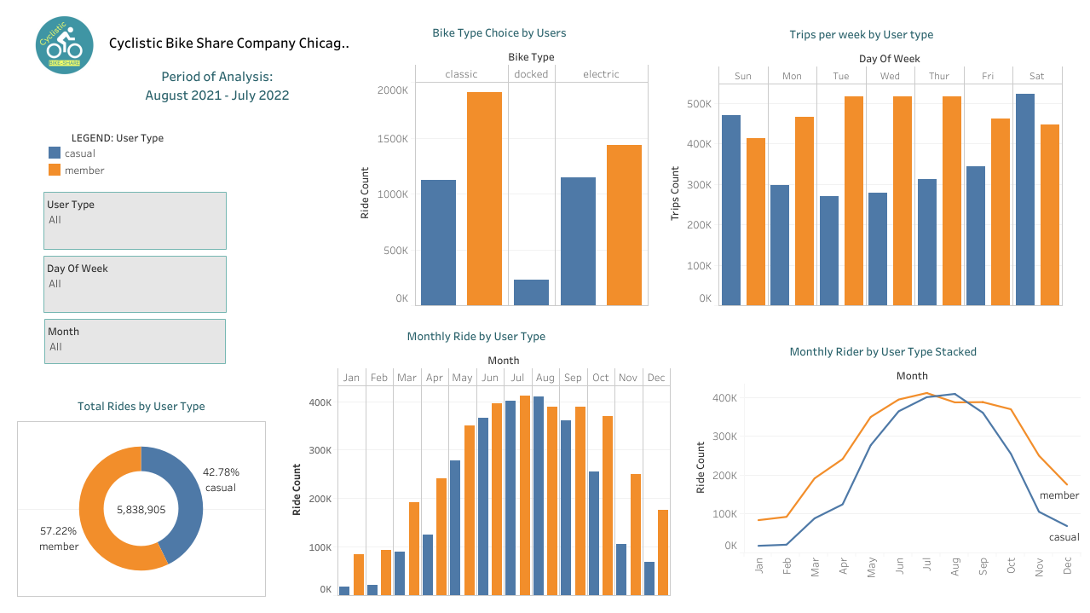
Visualization

Slide 7
Findings
Only Casual Riders used the Docked Bikes during the period
Casual Riders use the bike services more on Saturdays and Sundays while Members are more active on weekdays
Casual Riders were more active in June and July (Summer Time) while Members were more active on other months of the last 12 months

Slide 8
Recommendations
The pattern noticed is that while the annual members are pretty regular and consistent, the casual riders are somewhat more given to weekends and holidays which would suggest why they may not have favoured memberships. Customers may feel cheated when subscriptions are period based and not ride based. If we develop a membership variant that bills per use then, casual riders would sign up more.
There is a clear improvement in casual rides during the holidays which may suggest tourists. Tourists may be more attracted to join membership if there is a flexible (flexi) membership that supports their tourism schedule.
Create events/promotions that gives discounts to members to show the preference of being a member.

Slide 9
THANK YOU

